Slide 1

Collecting and Analyzing Large Data Project
Optimizing Spotify Music Discovery Experience
Group 2 (Yellow)
Aman • Nivan Vora• Gabriel Andaya • Menji Wei
Project Overview
Developing an innovative song recommeder feature to create a more personalized music discovery experience for Spotify users
Notes:
Hello, everyone welcome to our presentation, we are group 2, and our group members are Aman, Nivan, Gabriel, and Menji.
todays topic is about optimizing Spotify music discovery experience.

Slide 2

Project Overview & Objectives
1
Enhance User Experience
2
Feature-Driven Optimization
Design an innovative feature for Spotify to improve user engagement through personalized music discovery experiences.
Develop new functionalities based on musical attributes (such as danceability, mood) to optimize music recommendation experience.
3
Data-Driven Design
Leverage the music recommendation system's ability to analyze song features and similarities to inform the design of new personalized discovery features, enhancing user engagement and creating tailored music exploration journeys.
Notes:
As starters, we found that Spotify's Recommender System owns a library of over 100 million tracks, influencing more than 30% of artists' monthly listeners through personalized playlists. Features like "Made for You" help users discover new artists via tailored, algorithm-driven suggestions.
Our Recommendation Model, on the other hand, delivers precisely matching songs based on the user's input. (根据用户的输入传输准确的歌曲)Our objective is to boost user engagement by creating personalized music discovery features through data-driven analysis of song attributes and similarities.
Moreover, users can enhance their recommendations by adjusting various song attributes such as loudness, speechness, danceability, and more.
Now it’s time for Aman to introduce more details of our project and the database used.

Slide 3
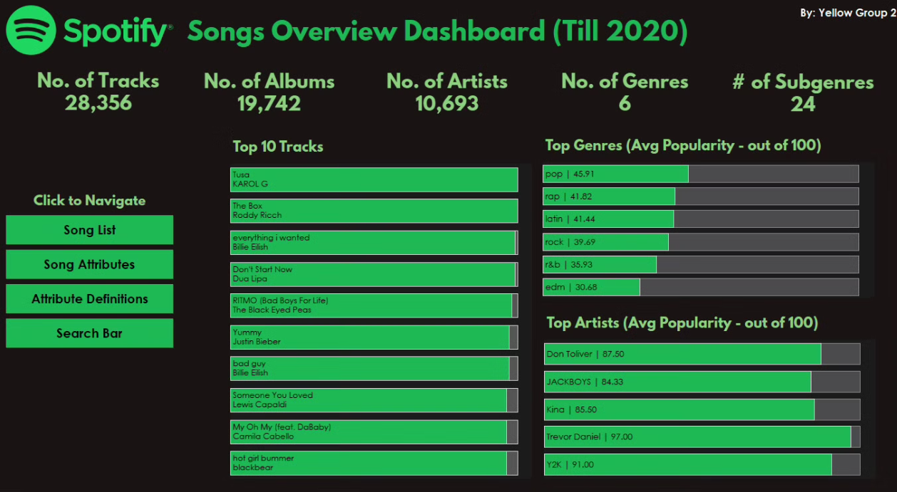
Database Summary
Analysis of more than 28000+ tracks on Spotify till 2020, reveals insights about music preferences and listening patterns:
1
Dataset Scale
2
Genre Performance
3
Top Performers
28,356 tracks (rows of data) across 6 genres and 24 subgenres, and varying attributes like danceability, energy, speechines, tempo, loudness, mode, speechiness, acousticness, instrumentalness, liveness and valence
Over 10,000 artists in genres like Pop, Rap, Rock and much more, visualised based on their average popularity. Genres are further subcaterized on the basis of Sub-Genres.
Information regarding artists like Trevor Daniel and Y2K who have achieved 90+ popularity scores, with hit tracks from KAROL G and Dua Lipa showing strong engagement.
Tableau Dashboard Main Page
Notes:
Thank you Menji
So, Our dataset initially contained over 30,000 records of and before the year 2020.. After a thorough data-cleaning process, we successfully retained more than 28,000 unique entries. We proceeded to analyze and visualize this data using Tableau, providing clear insights and visual representations. The user is welcomed by the overview dashboard which looks something like this. We can find quick facts about the data and information about what the most popular tracks were pre 2021, the top genres and Top artists.
This dashboard is fully interactive and the user can go back and forth, moving on, we have the Song List page,
Here, the user can decide how many songs to display and can filter the displayed songs on release year, genres and sub genres

Slide 4
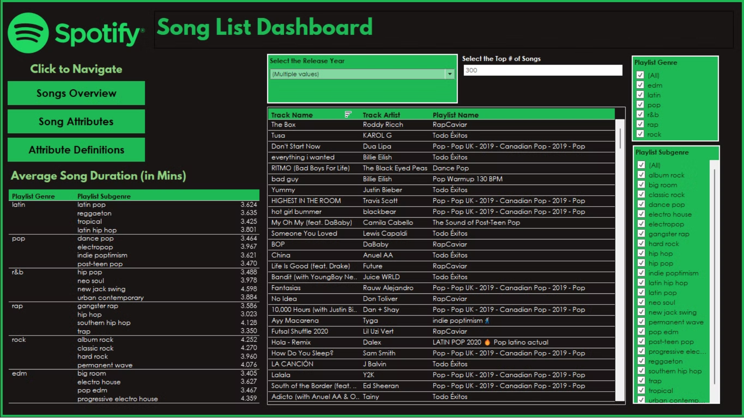
Here, the user can decide how many songs to display and can filter the displayed songs on release year, genres and sub genres
Song List Page
Notes:
Next is, The song Attributes Page, where Users can interact with the soundwave visualization by clicking anywhere on it. When a user selects a point on the soundwave, a specific song is chosen, and detailed information about that song's attributes is displayed. Additionally, the song's position is highlighted on a scatterplot, showing how its attributes compare to those of other songs in the database.

Slide 5
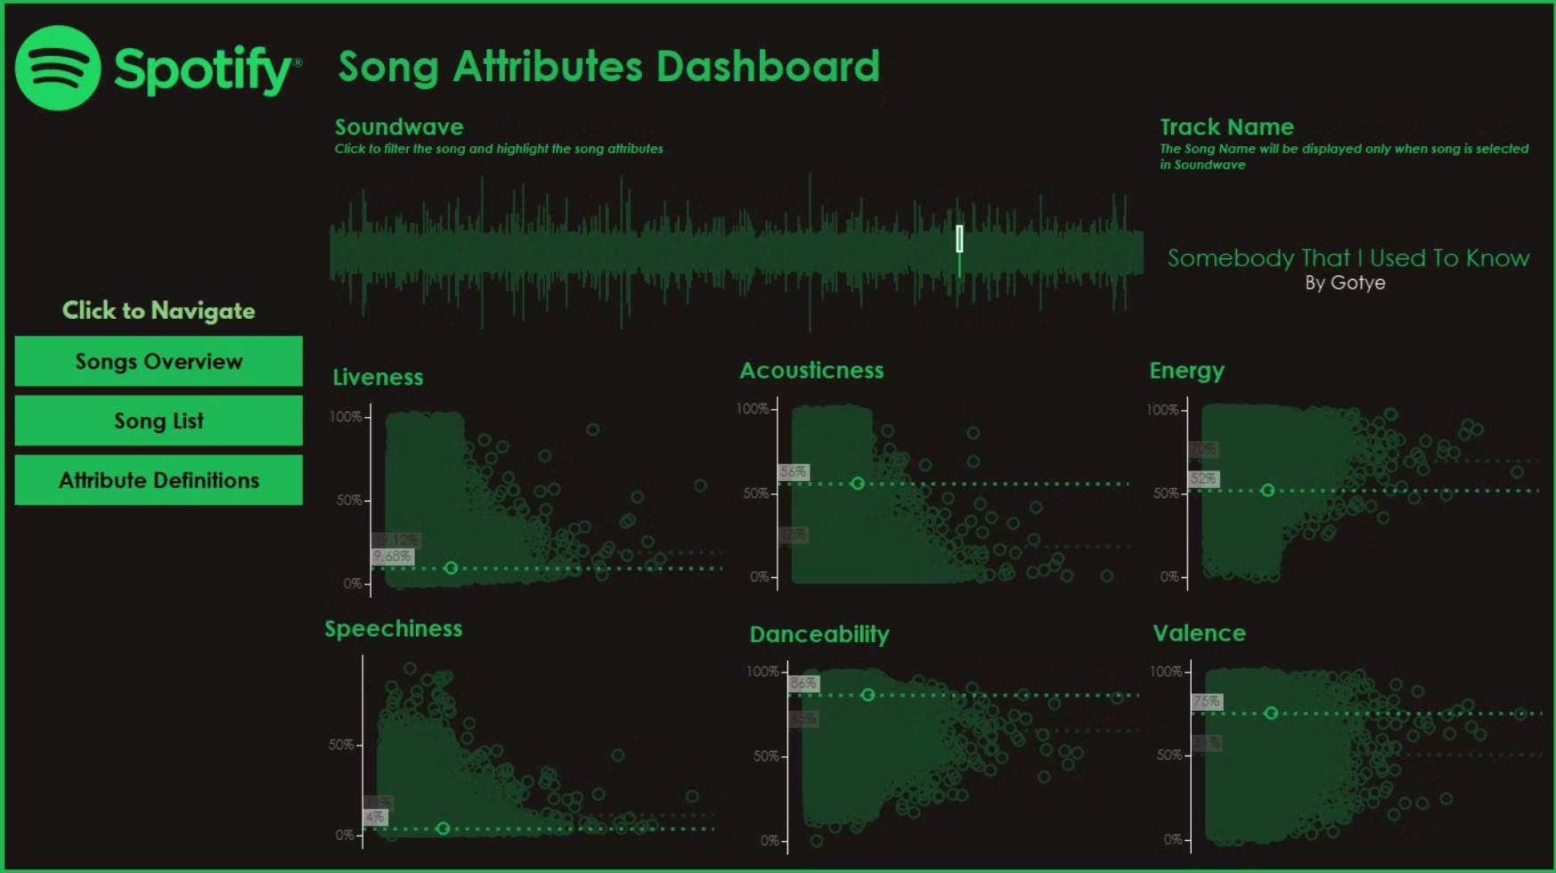
Song Attribute Page
Users can interact with the soundwave visualization by clicking anywhere on it. When a user selects a point on the soundwave, a specific song is chosen, and detailed information about that song's attributes is displayed. Additionally, the song's position is highlighted on a scatterplot, showing how its attributes compare to those of other songs in the database.

Slide 6
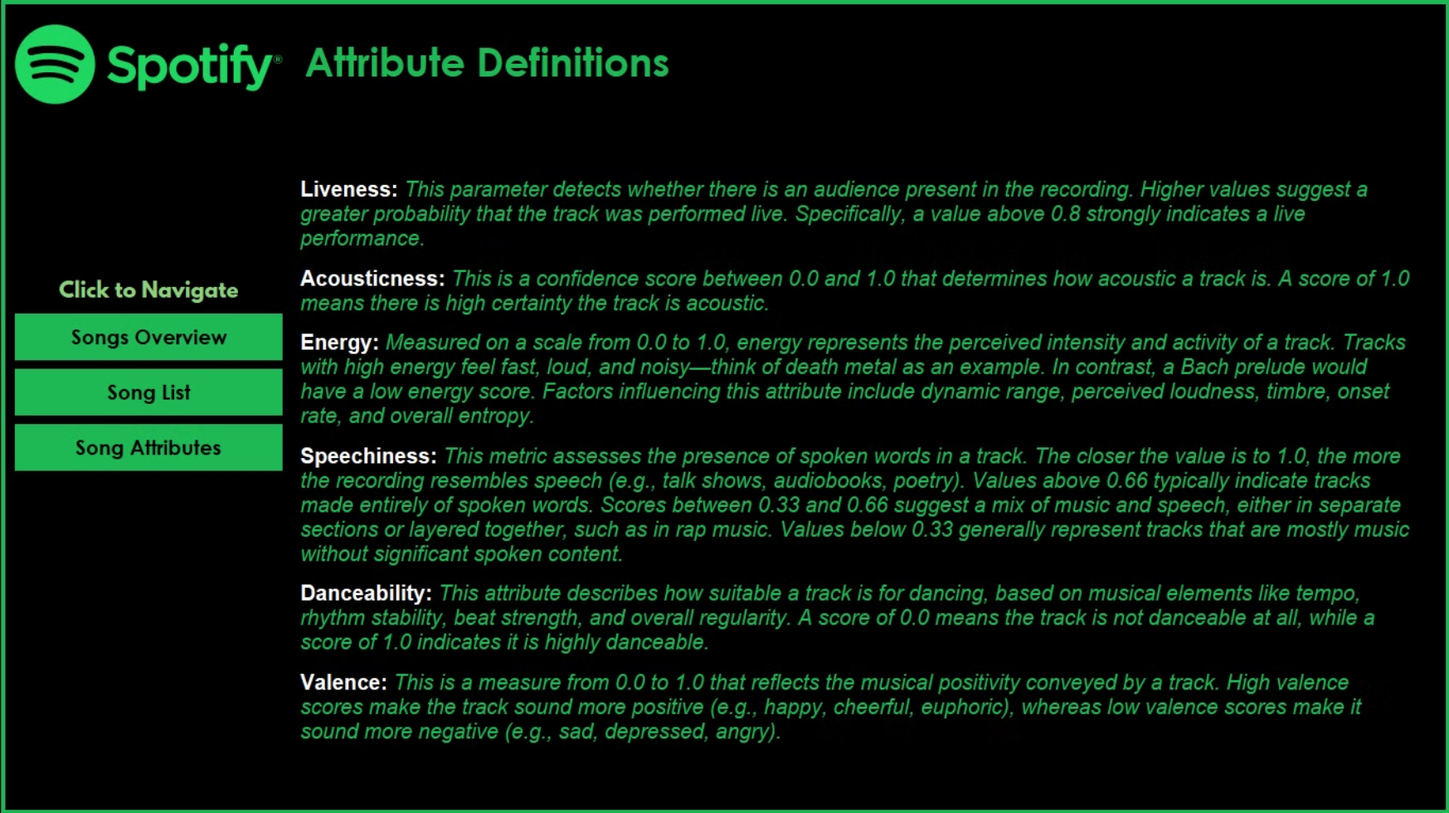
Attribute Definition Page
Notes:
And we also have a page where what each attribute is, is explained.

Slide 7
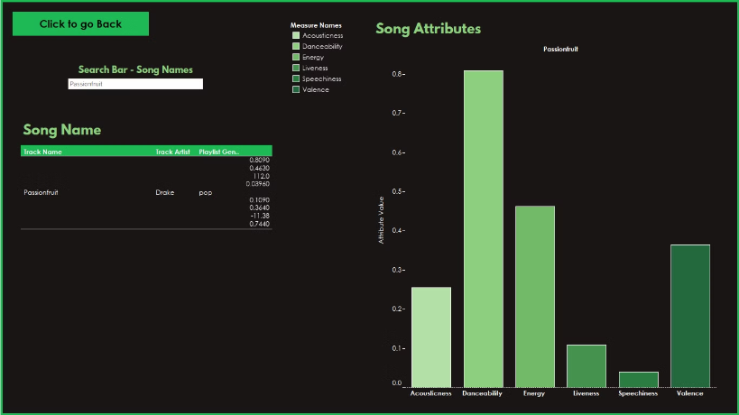
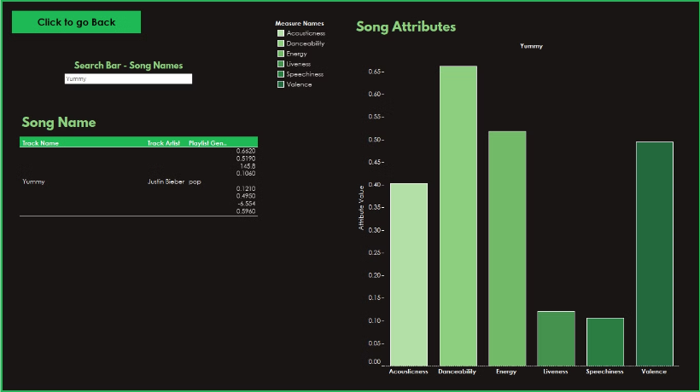
Search Bar Page
Users can look up a specific song they desire and receive detailed information about its various attributes.
Notes:
Last we have the Search Bar page, here Users can look up a specific song they desire and receive detailed information about its various attributes. In the images, I have typed the song “Passionfruit” by Drake and “Yummy” by Justin Beirer, these were some hits we had back in the day, and we can see their attributes.

Slide 8
Feature Demonstration
In this section, we will demonstrate our Song Recommender feature and how it functions, showcasing how they improve the music discovery experience for users.

Slide 9
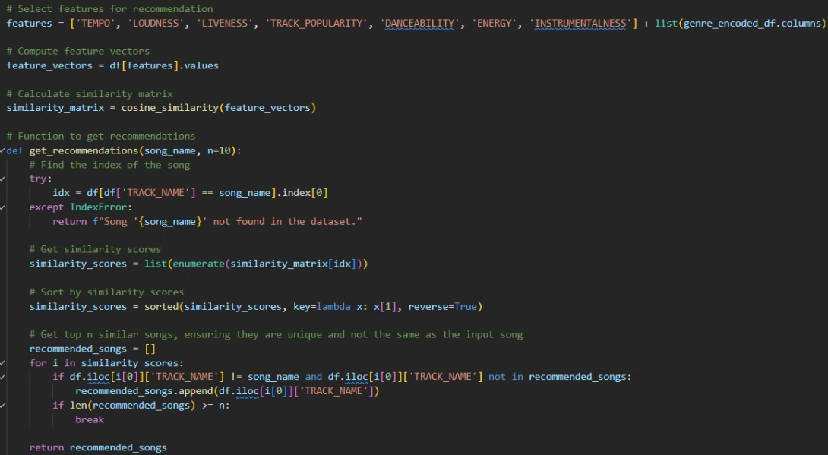
Code Implementation
Graphical User Interface (GUI):
Built with tkinter
Allows users to input a song name.
Includes sliders for adjusting various feature weights (e.g., tempo, loudness, popularity).
Recommendation Algorithm:
Uses cosine similarity to calculate the closest matches based on user input and selected weights.
Presents a list of recommended songs to the user.
Usability Enhancements:
If the entered song name doesn't exactly match any in the dataset, the program suggests the closest match.
Ensures a user-friendly experience by handling input discrepancies effectively.
Notes:
Thank you Aman
Let’s start with the code implementation behind the Spotify Song Recommender system. This project combines Python and Tkinter to create a personalized music recommendation tool. The dataset contains songs and their features, such as tempo, loudness, and energy. At its core, the system uses *cosine similarity* to compare songs based on these features and suggest similar ones. The GUI, as you’ll see, is designed to be user-friendly, allowing users to input a song name and adjust sliders to assign weights to features like danceability or track popularity.
If a song isn’t found due to a typo or slight variation in spelling, the system suggests the closest match from the dataset, ensuring usability. This makes it accessible to a wide audience and ensures that recommendations are accurate.

Slide 10
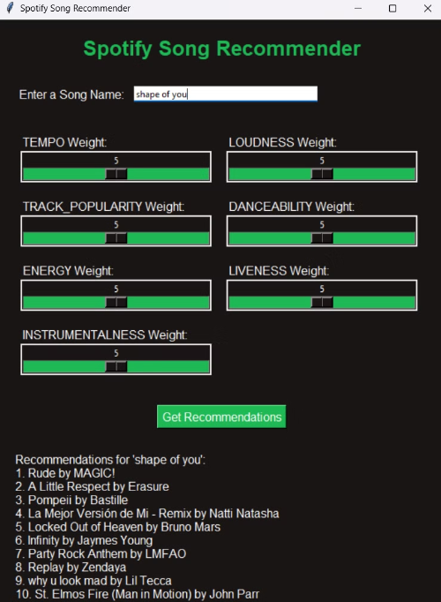
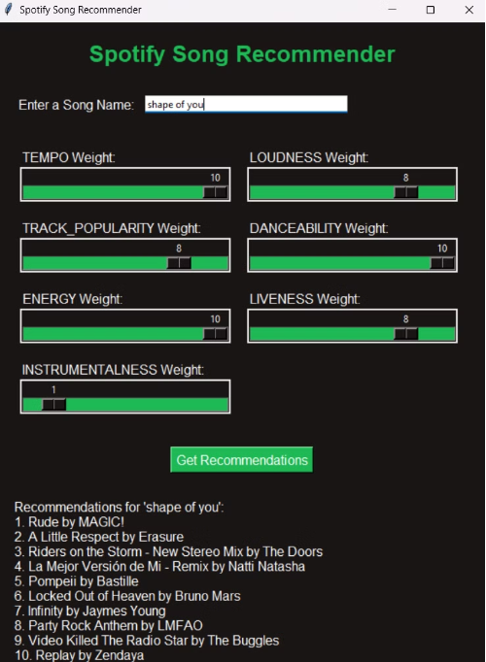
GUI Presentation
Same Weights
Personalized Weights
Notes:
Now let’s look at the GUI in action. On the left, we see a scenario where all feature weights are evenly distributed. On the right, you can see how adjusting weights for features results in a different set of recommendations tailored to the user’s preferences.
This slider-based approach empowers users to experiment with feature combinations and discover music in a way that aligns with their mood or taste and could also be used to curate playlists for particular genres or audience preferences. Next, I’ll demonstrate the live functionality of this GUI, highlighting how interactive and adaptable the system is for users
Now its time for Gabriel to present the next slides

Slide 11
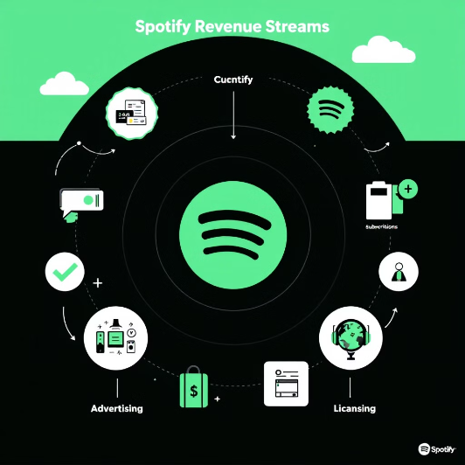
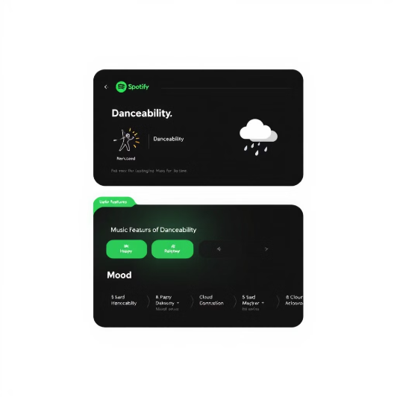
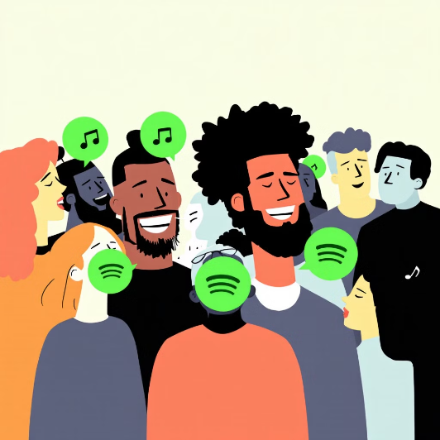
Business Opportunities and Target Users
Business Opportunities
Product Features
Target User Groups
Revenue generation through API subscription model
Music recommendations based on danceability
Music enthusiasts seeking personalized experiences
Data analytics services for music companies
Adjustable sliders based on preference
Explorers looking for new music
Notes:
Business Opportunities:
2 main points are revenue generation with an API subscription and Data Analytics as a service for music companies
For instance, our database is developed through a Snowflake warehouse that is connected to our application via an API we developed through Google Cloud Platform. That API can be sold via subscription to any company that wants our data on danceability, speechness, and other parameters.
We can also offer our expertise to other companies to enhance their data to include these features.
Product features:
Our recommendation system is based off feature parameters such as danceability, and Tempo through the slide bars
Target User Groups:
Our main audiences are music enthusiasts that are searching for new songs more tailored towards their mood

Slide 12



Feature Monetization Strategy
Premium Feature Integration
Partner Integration
Enhancing User Experience
Introduce advanced music mood and energy level filters as premium features, creating new revenue streams through enhanced subscription tiers.
Enable third-party applications to integrate our feature APIs, generating revenue through API licensing while expanding the ecosystem.
Provide enhanced music recommendations by leveraging feature-based similarity analysis, offering users a tailored and engaging listening experience. Users gain more control over their music journey with intuitive features that help them discover songs matching their exact preferences and current mood.
Notes:
Feature Monetization Strategy:
Premium Feature Integration
A new premium feature that allows users to adjust the music recommendation according to their mood and energy.
This will be an add-on feature when subscribed to premium account
Partner integration
Another revenue source is licensing the API of the features. Much like the database, the features for the front-end of the application can be sold through a licensing agreement.
This allows for the product to be marketable to other companies and not solely in house
Enhance User Experience
Ultimately, the main objective is to give our listeners an enhanced experience with our new product. We want our audience to be able to leverage these features that allow them to tailor their unique taste to them.

Slide 13
Limitations
Dependence on Dataset Quality: The accuracy and relevance of recommendations are highly dependent on the completeness, diversity, and accuracy of the dataset used. If the dataset lacks variety or contains outdated information, the recommendations may not reflect current user preferences.
Exact Match Requirement: Although the project incorporates fuzzy matching, users may still face difficulties if the entered song name significantly deviates from the dataset's format, limiting accessibility for users unfamiliar with the exact titles.
Scalability Issues: The algorithm might face issues with scalability when applied to very large datasets, as the computation of similarity matrices can become resource-intensive, potentially leading to slower performance.
Notes:
Limitations:
Dependence on the database
The lack of up to date music songs and artists limits the listener to a time interval of music created before a given date.
Exact match:
Users might come across difficulties entering songs with the same name but different artists. It can limit access to users attempting to enter songs they may not remember the name to.
Scalability Issues:
The larger the dataset, the larger resource-intensive it becomes which may lead to slower performance from our application.

Slide 14
Thank You for Your Attention
Thank you very much for your interest!
Questions Welcome
We are happy to answer any questions
Open Discussion
Looking forward to in-depth conversations with you

